Slide 1

Immigrant Discourse & the Age of Trump
ON REDDIT WITH NLP METHODS
Miftahul Jannat Mokarrama, Alex Morales Flores, & Anh Nguyen Tran
SICSS-UCLA
08/29/2025

Slide 2

How did Reddit discourse on immigration shift from January to July 2025 across r/immigration, r/politics, and r/PoliticalDiscussion?
1
Research
Questions
Which frames dominated the Reddit discourse (e.g., Security, Economy, Culture/Identity, Law/Humanitarian)?
2

Slide 3
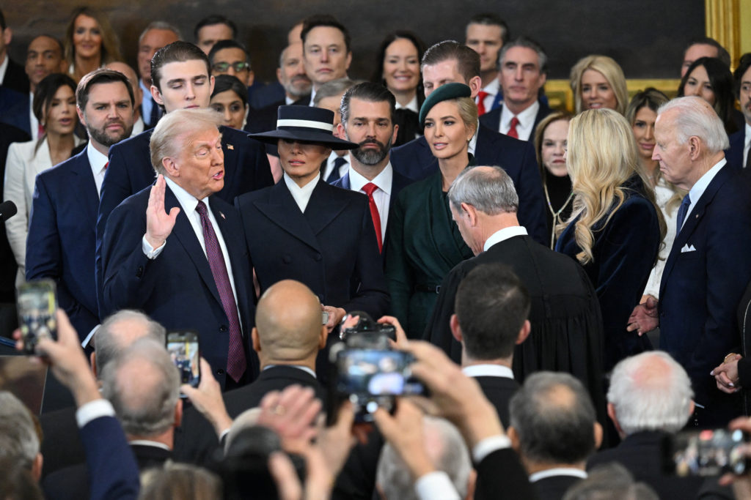
Background
What is the current political landscape?
January 2025: Trump’s inauguration
February 2025: Trump appoints personnel at Guantanamo Bay for detention and begins transfers
March 2025: Trump expands expedited removal and enacts Alien Enemies Act
April 2025: Trump threatens “sanctuary cities”

Slide 4
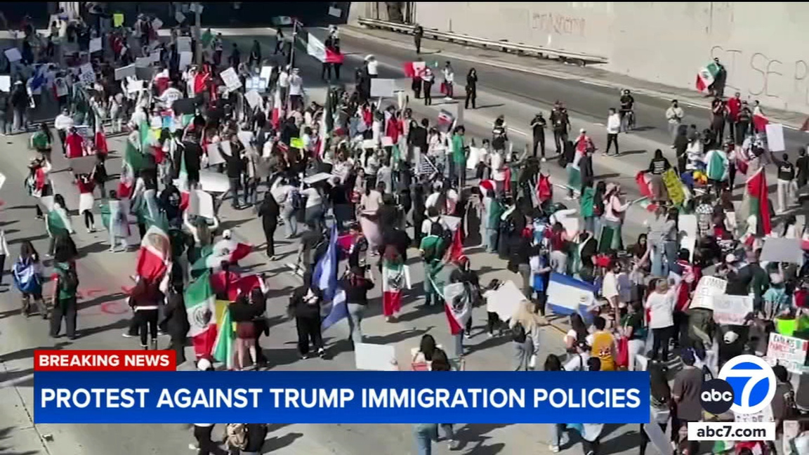
Background
What is the current political landscape? cont.
May 2025: Trump offers financial incentive for self-deportation and designates some parts of the U.S.-Mexico border as militarized zones
June 2025: Trump sends in ICE agents and then the National Guard to Los Angeles
July 2025: “Big Beautiful Bill” is signed which expands detention centers and increases ICE’s budget

Slide 5
Data
Reddit is not representative of the entire American population. Around 50 million American are active on Reddit everyday (Backlinko 2025). Two-thirds of Reddit users are male, and 44% are aged 18 - 29 (Duarte 2025). Overall, Redditors are left-leaning politically (Jungherr, Posegga, and An 2021).
r/immigration
r/politics
r/politicaldiscussion
224k members total
Users discuss immigration news, politics, visas, green cards, raids, deportations in both the US and worldwide
Gives us a lot of immigration-specific discourse and posts from individuals going through the immigration process
8.9 million members total
Users discuss US news related to politics
Most posts are links to news articles
Left-leaning bias with most users supporting Democratic policies and candidates (Godfrey 2024)
2.2 million members total
Users make substantive and civil discussion on political topics
Most posts are either policy and current affairs questions or strong political opinions a user might have

Slide 6
Data Collection Process
We collected top posts from January to July 2025 from the 3 subreddits previously identified (r/immigration, r/politicaldiscussion, and r/politics).
Our data includes post title, post text, 3 comments connected to those posts, date of post creation, and upvotes for the post and comments.
We used the official Reddit API access available for developers to collect the data. Reddit limits how much data you can download at a time.

Slide 7
Example Post (r/politicaldiscussion)
LINK: https://www.reddit.com/r/PoliticalDiscussion/comments/1ljxdat/why_does_enforcement_of_immigration_policy_result/
POST TITLE: “Why does enforcement of immigration policy result in rioting instead of examination of the actual policy?”
POST DATE: June 25, 2025
POST TEXT: “Why object to ICE enforcing the law (policy) instead of objecting to the law (policy) itself? ICE officers are doing their job (which is: enforcing the law). If the policy) law is wrong, Congress should change it. ICE officers are required to enforce the law. Protesting is a Constitutionally protected activity, but rioting is not. Rioting is a crime, and rioting is not an appropriate response to law enforcement activity.”

Slide 8
Example Post (r/politicaldiscussion)
COMMENT 1: “The "law" gives judges the power to make rulings and law enforcement is legally bound to abide by those rulings. If a judge makes a court order the barres someone from being removed from the country, it's a violation of the law to deport him anyway. The deportation of Garcia was an illegal act and not just people doing their job. The law doesn't give ICE the power to arbitrarily overrule judges.”
COMMENT 2: “It's hard to believe your question is in good faith when your premise is that there is somehow widespread rioting. The fact is that the vast, vast majority of pushback has been peaceful protests and it has been law enforcement that has escalated the situation.”

Slide 9
Example Post (r/politicaldiscussion)
COMMENT 3: “I think it's important to be precise with our language here. Calling these events riots is misleading, as the reality is that they are overwhelmingly peaceful protests. Focusing only on a few isolated incidents of conflict, which is a common media narrative, distorts the much larger picture of why people are demonstrating in the first place. And that bigger picture often comes down to the policy's implementation. A law on paper is one thing, but how it's enforced is just as important. When the public sees enforcement that involves overwhelming force, tactics that treat people as a monolithic group of criminals, or even raids that target schools and silence dissent, the policy loses its legitimacy. That deep sense of injustice, not an opposition to law itself, is what truly fuels such a strong public response. A particularly horrifying example of this injustice happens inside the courtrooms themselves......”

Slide 10
Data Pre-Processing
Type check & convert input to string
Remove diacritics/normalize accents
Lowercasing
Remove URLs, user mentions, subreddit mentions (via regex)
Remove/replace emojis
Replace HTML escape entities (&, <, etc.)
Remove any remaining URLs
Remove punctuation
Collapse multiple spaces
Normalize hyphenated tokens (e.g., j-1 → j1)
Remove control characters (newline, tab, carriage return)
Final whitespace cleanup

Slide 11
Natural Language Processing (NLP)
We ran NLP on all texts (both posts and comments)
Sentiment analysis: Emotional tone/attitude
Stance analysis: Pro-migration and anti-migration terms
Framing analysis: 8 frames on content in immigration discourse
Latent Dirichlet Allocation (LDA): Generative probabilistic topic model
Dynamic Topic Modeling: Captures semantic meaning and context over time
Co-occurrence networks: How often terms appear together in the same context

Slide 12
Sentiment Analysis
Sentiment analysis continuous compound score (VADER):
1: most positive
Example: “Inspiring to see solidarity against deportation” or “It’s a relief to see these raids happening because we need more law and order”
0: neutral
-1: most negative
Example: “The ICE raids were brutal and horrible for immigrant families”
Provides insight into emotional intensity in discourse
Detects when immigration-related events (e.g., deployment of National Guard) trigger strong emotions

Slide 13
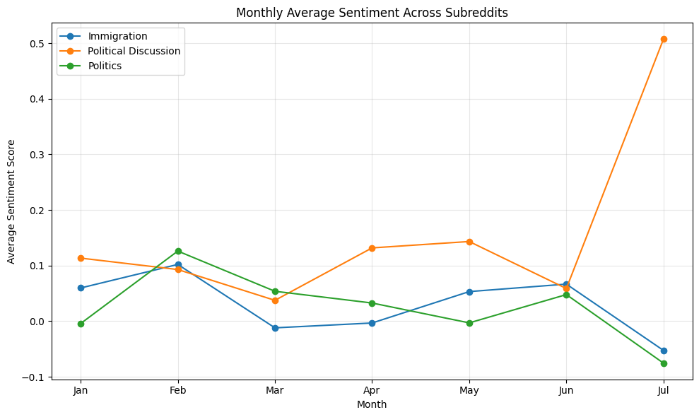

Slide 14
Stance Analysis
Detects where someone broadly stands on the issue of immigration
Pro-immigration terms include phrases like “due process” (in the context of ICE raids) and “pathway to citizenship”
Anti-immigration terms include phrases like “illegal aliens”, “anchor babies”, and “deport them all”

Slide 15
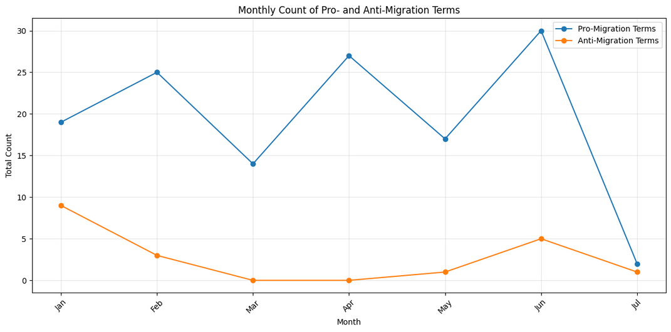
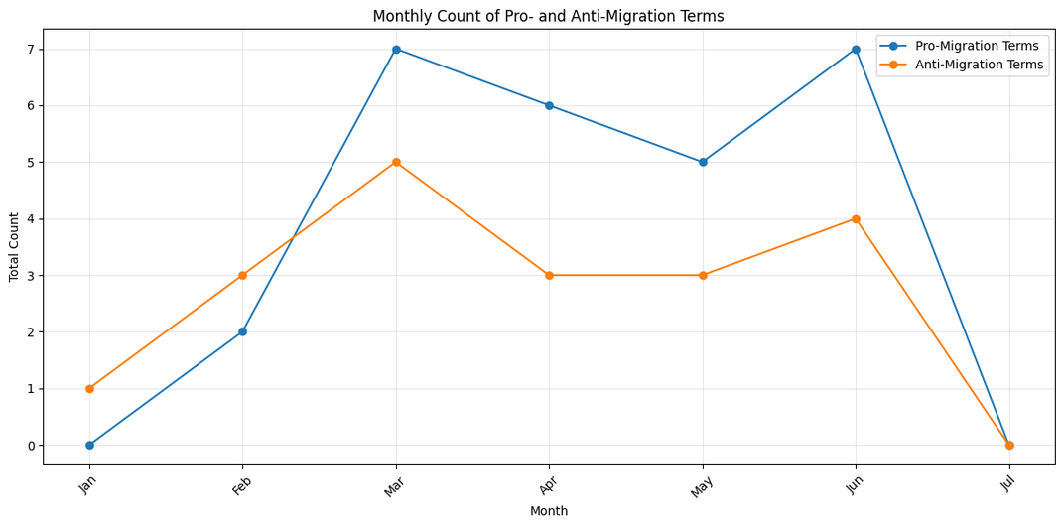
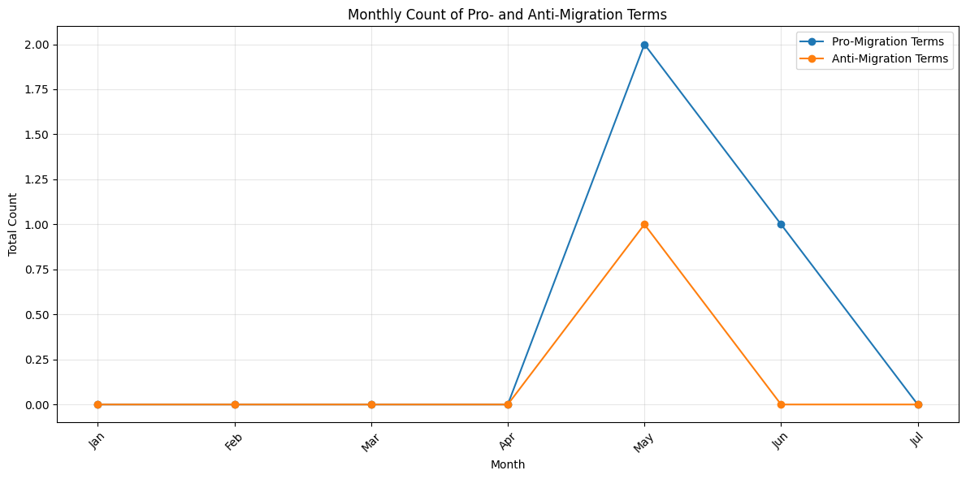
r/immigration
r/politicaldiscussion
r/politics

Slide 16
Framing Analysis
Frames (content of discourse on immigration) tracked:
birthright citizenship (e.g., “end birthright citizenship”)
enforcement and detention (e.g., “detention center”)
deportation and removal (e.g., “deport them all”)
asylum and refugees (e.g., “refugee status”)
citizenship and passport (e.g., “citizenship interview”)
visa process (e.g., “visa interview”)
immigration for work (e.g., “work authorization”)
politics and Trump’s campaign (e.g., “executive order”)

Slide 17
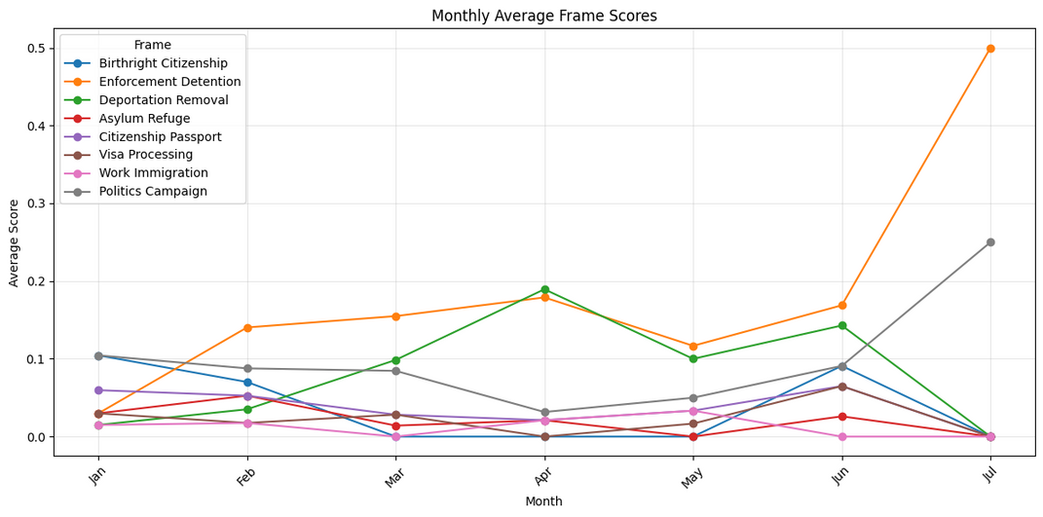
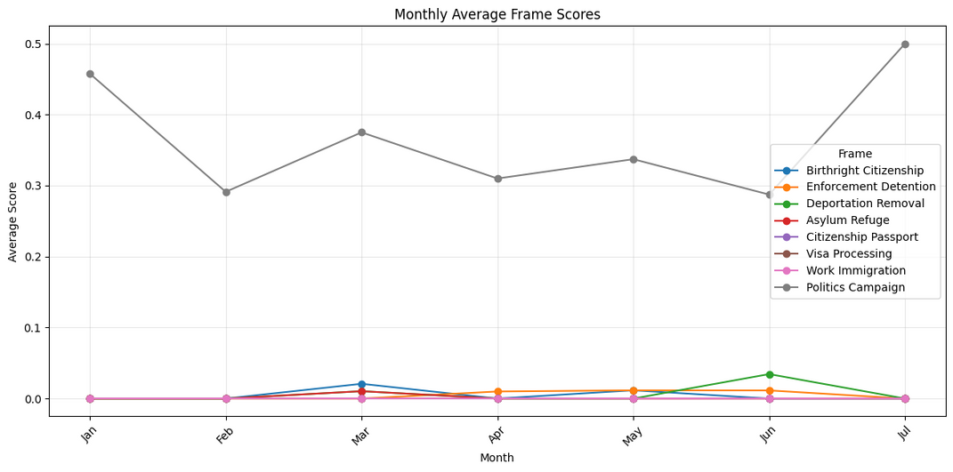
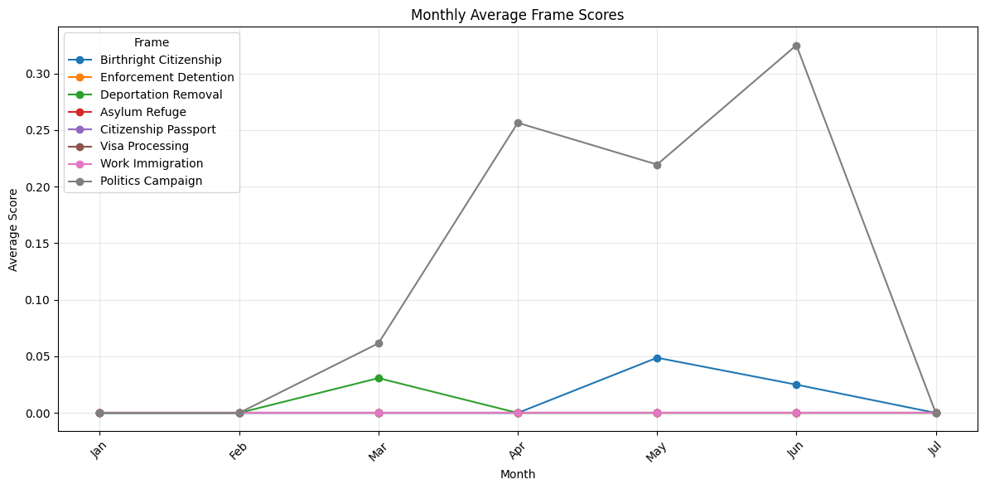
r/immigration
r/politicaldiscussion
r/politics

Slide 18
LDA
Word cloud generated for LDA
LDA gave us distributions of words with probabilities (topics), and a word cloud visualizes the most frequent (or highest-weight) words
We ran this on all discourse in the subreddits, not just on immigration discourse

Slide 19
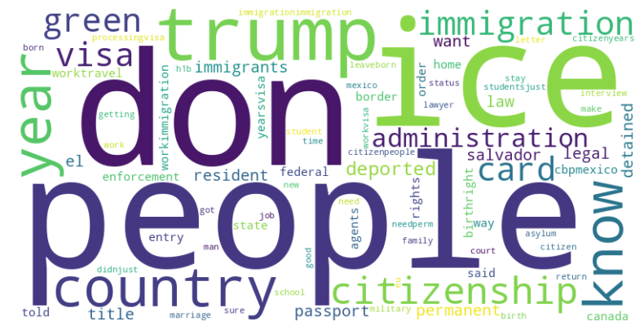
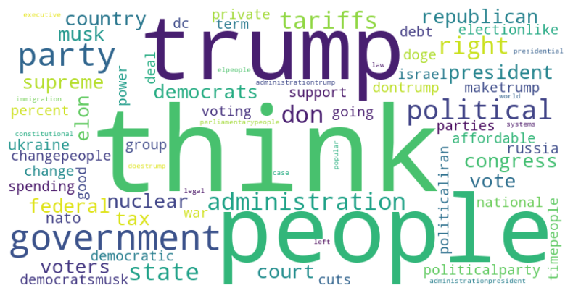
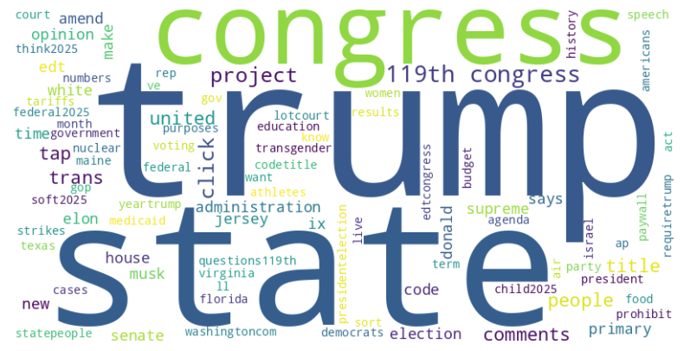
r/immigration
r/politicaldiscussion
r/politics

Slide 20
Dynamic Topic Modeling
Dynamic topic modeling is an extension of traditional topic modeling (like LDA) that accounts for how topics change over time
Shows how the vocabulary, framing, and salience of topics evolve instead of assuming topics are static

Slide 21
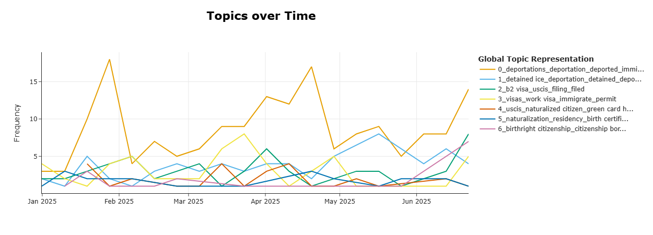
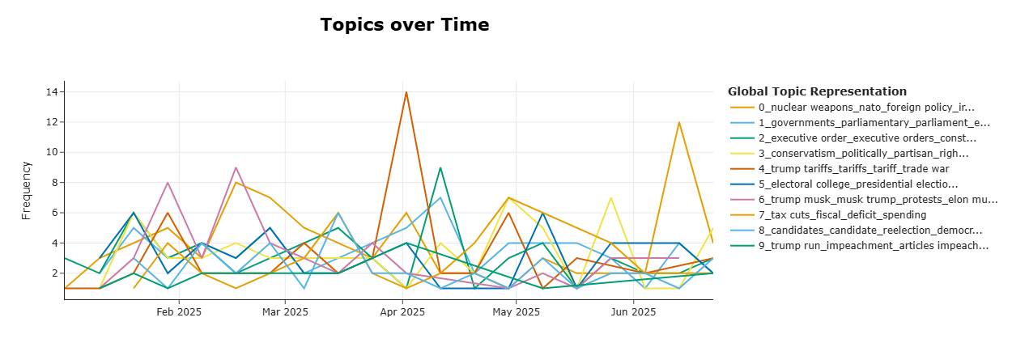
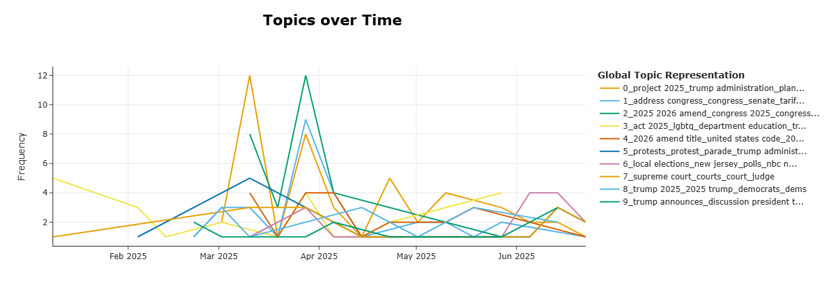
r/immigration
r/politicaldiscussion
r/politics

Slide 22
Co-Occurence Networks
Visual makes the structure of discourse visible in a way that simple frequency counts (like word clouds) cannot.
Highlights clusters of words that tend to appear together in the same Reddit comments or posts
A line appears if two words occur together in the same unit of text (like the same Reddit comment) above a chosen threshold
Each colored cluster represents a theme in discourse
Some words are in the center connecting multiple themes

Slide 23
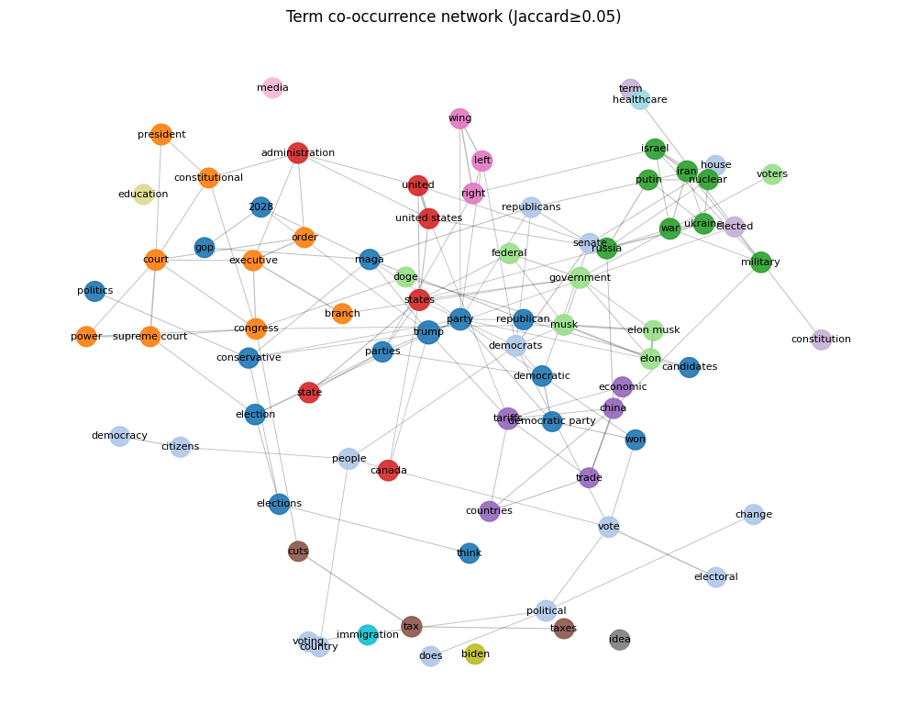
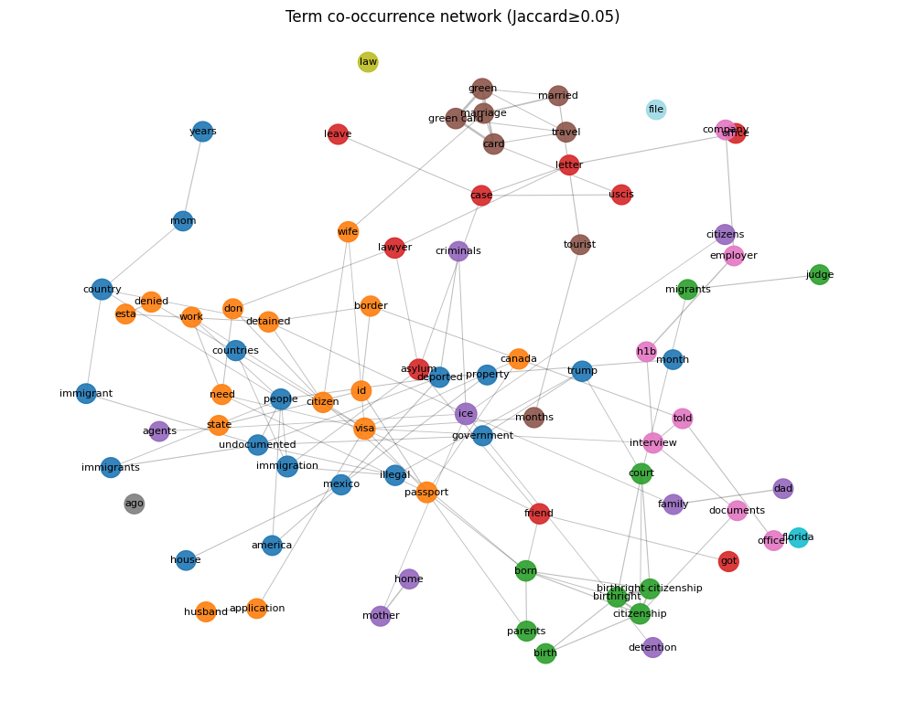
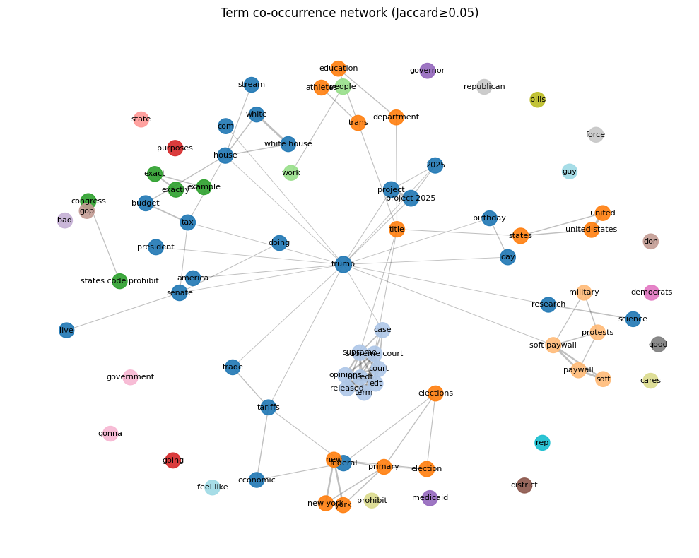
r/immigration
r/politicaldiscussion
r/politics

Slide 24
R/IMMIGRATION

Slide 25
R/POLITICAL DISCUSSION

Slide 26
R/POLITICS

Slide 27
Key Takeaways
This is exploratory work so far, but as the data shows, there has been sharp increases on discussion about immigration on Reddit and major shifts in the emotions.
We hope to expand on this by collecting data from more subreddits (e.g., ones dominated by women; more general subreddits that are not focused on politics). We also need to fine-tune some models.

Slide 28
Future Directions
In the future, we want a longer timeline essentially on the evolution of immigration discourse on Reddit.
We will look at other datasets as well.
While Internet discourse does not constitute action, studying discourse can still give us insight into how resistance to government actions/policies may change and stabilize over time in the online sphere.
For the models:
Lemmatization and stemming for text processing

Slide 29
Thanks for listening!
ANY QUESTIONS? 🫵
EMAILS:
mmokarrama@niu.edu
amoralesflores@ucsd.edu
anguyentran@ucmerced.edu
GITHUB: Private for now!!

Slide 30
References
Backlinko Team. 2025. “Reddit User and Growth Stats.” BackLinko, August 4. https://backlinko.com/reddit-users.
Duarte, Fabio. 2025. “Reddit User Age, Gender, & Demographics (2025).” ExplodingTopics, June 23. https://explodingtopics.com/blog/reddit-users.
Godfrey, J.T. 2024. “New Study on Reddit Explores How Political Bias in Content Moderation Feeds Echo Chambers.” Michigan Ross, October 18. https://michiganross.umich.edu/news/new-study-reddit-explores-how-political-bias-content-moderation-feeds-echo-chambers#:~:text=For%20regular%20users%20of%20Reddit,limited%20to%20any%20one%20side.

Slide 31
References
Jungherr, Andreas, Oliver Posegga, and Jisun An. 2021. “Populist Supporters on Reddit: A Comparison of Content and Behavioral Patterns Within Publics of Supporters of Donald Trump and Hillary Clinton.” Social Science Computer Review 40(3): 809-830.

